Slide 1

B. TECH PROJECT (CSPE 40) HUMMING-BASED MUSIC (HBC) INFORMATION SEARCH
Shubham Singh Kunwar (11912079)
Peeyush Chaudhary (11912085)
Naman Kumar Singh (11912096)

Slide 2
CONTENT
Introduction
How HBC Information Search Works
Advantages of HBC Information Search
Limitations of HBC Information Search
Applications of HBC Information Search
Future Scope
Conclusion

Slide 3

INTRODUCTION
Humming-Based Music (HBC) Information Search is a unique way of searching for music using humming or singing. It is a revolutionary technology that has made it possible for people to find songs they don't know the title or artist of, just by humming or singing a few bars of the melody.
The technology behind HBC Information Search is based on sound recognition algorithms that are able to analyze the melody and rhythm of a person's humming or singing and match it with the closest possible song in its database.

Slide 4

HOW HBC INFORMATION SEARCH WORKS
To use HBC Information Search, all you need to do is hum or sing a few bars of the melody of the song you're looking for into your device's microphone. The algorithm then analyzes the sound and matches it with the closest possible song in its database.
The accuracy of HBC Information Search depends on the quality of the humming or singing input. The more accurate the input, the higher the chances of getting an accurate result.

Slide 5
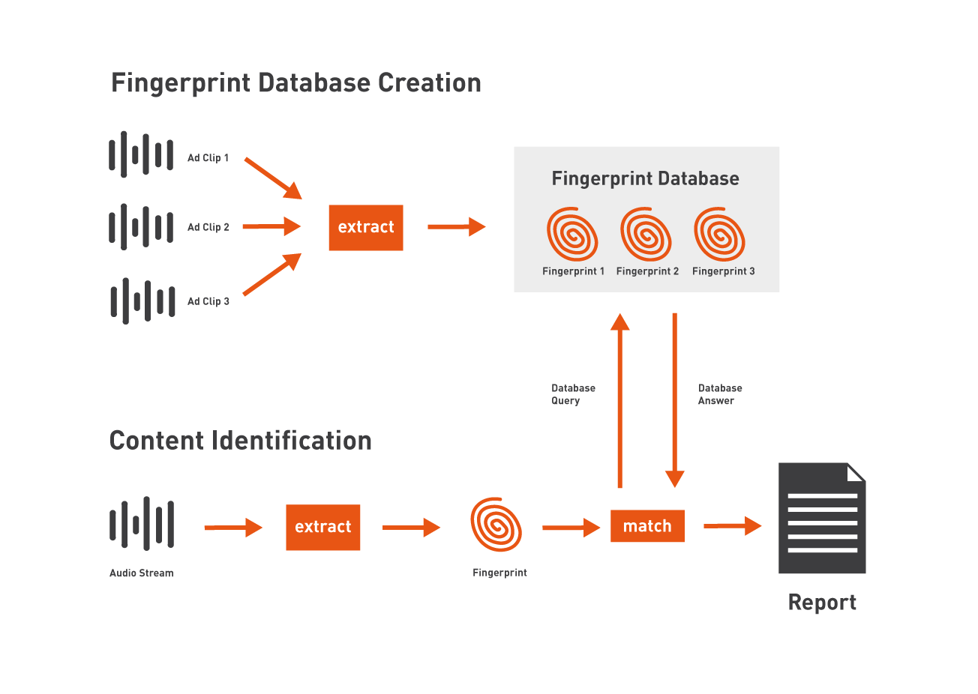
AUDIO FINGERPRINT
Audio fingerprinting is a technique used to identify audio files based on their unique characteristics. It involves analyzing the waveform of an audio file and creating a digital signature that can be compared to other audio files to determine if they are similar.
This technology has many applications, including music identification, copyright protection, and forensic analysis. It is also used in various industries such as entertainment, security, and law enforcement.

Slide 6
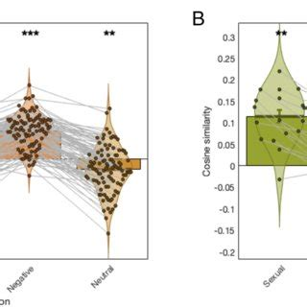
WORKING OF AUDIO FINGERPRINT
Create a spectrogram and find vector of value at specific frequency, time and amplitude.
Based on the neighbor find the mean value which at as the audio fingerprint of the audio clip.
Comparison of the audio fingerprint of the humming clip with the database is done in order to find the song which match with the humming clip based on the cosine similarity between the song .
Display the song with the highest cosine similarity as the song with the highest similarity with the humming clip.

Slide 7
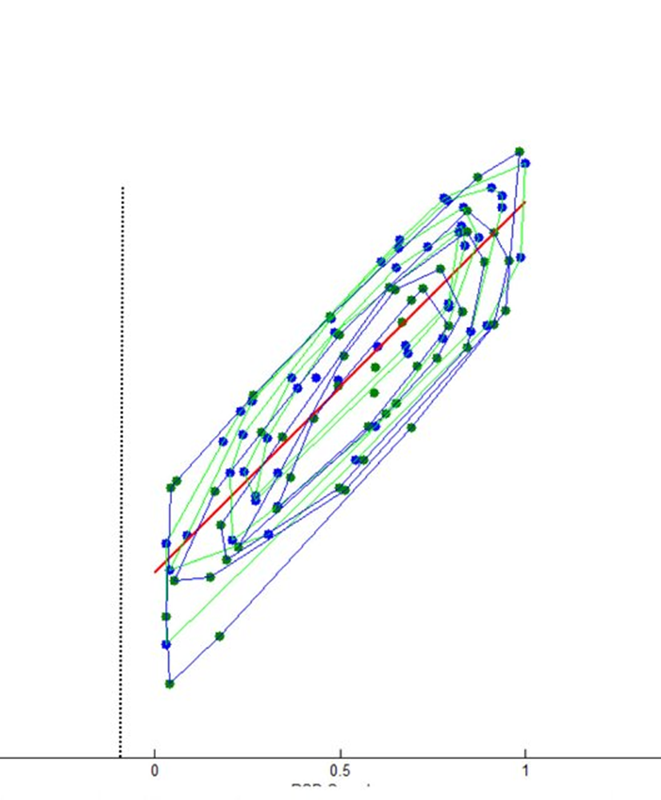
CHALLENGES OF AUDIO FINGERPRINT
While audio fingerprinting is a powerful technology, it is not without its challenges. One of the biggest challenges is dealing with variations in the audio, such as changes in pitch or tempo. This can make it difficult to accurately match audio fingerprints to each other.
Another challenge is dealing with large databases of audio fingerprints. As the number of audio files increases, it becomes more difficult to efficiently compare them to each other. This requires advanced algorithms and computing power to handle the massive amounts of data.

Slide 8

ADVANTAGES OF HBC INFORMATION SEARCH
One of the biggest advantages of HBC Information Search is that it allows people to find songs they don't know the title or artist of, which can be a frustrating experience. It also eliminates the need for typing in lyrics or trying to describe the song using keywords.
Another advantage of HBC Information Search is that it is fast and convenient. It only takes a few minutes to get a result, and you can use it anywhere, anytime, as long as you have your device with you.

Slide 9
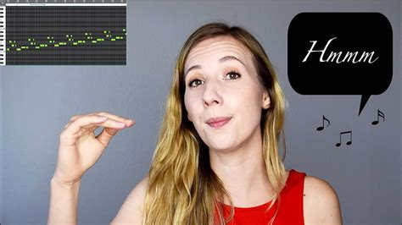
LIMITATIONS OF HBC INFORMATION SEARCH
While HBC Information Search is a great tool for finding songs, it does have some limitations. One of the biggest limitations is that it relies on the user's ability to hum or sing accurately. If the input is not accurate, the algorithm may not be able to match it with the correct song.
Another limitation of HBC Information Search is that it may not work well with obscure or less popular songs that are not in its database. In such cases, the algorithm may not be able to find a match.

Slide 10
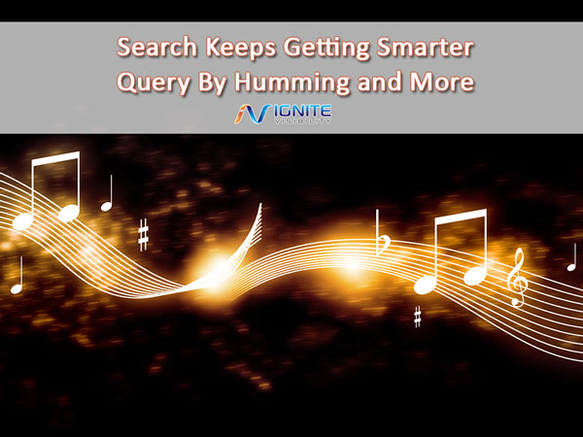
FUTURE SCOPE
Humming based music information search has a lot of potential for future development and improvement. The project could be further improved by utilizing more sophisticated algorithms and techniques, such as natural language processing and deep learning. Additionally, the project could be expanded to include other media, such as images and videos.
The project could also be extended to include other types of music information, such as lyrics and album information. Additionally, the project could be integrated with other music streaming services, allowing users to quickly and easily access music from various sources. These are just a few of the possibilities for the future of this project.

Slide 11

CONCLUSION
In conclusion, Humming-Based Music (HBC) Information Search is a powerful tool that has revolutionized the way we search for music. It is fast, convenient, and eliminates the frustration of trying to find a song without knowing its title or artist.
While it does have its limitations, the potential applications of HBC Information Search are vast and varied, making it a valuable technology for music education and entertainment

Slide 12
THANK YOU

